Slide 1
Tips dan Trik Submission
Menjadi Android Developer Expert
Reza Agustiana
Google Developers Kejar 2019

Slide 2


Reza Agustiana
Android Developer at Telkom MDD
agustiana@reza.web.id
reza-id

Slide 3


Submission 1
Aplikasi Movie Catalogue

Slide 4

Kriteria pada Fitur Daftar Film
Menggunakan ListView untuk
menampilkan data film dengan
jumlah minimal 10 item

Slide 5
Kriteria pada Fitur Detail Film
Menampilkan Poster dan Informasi Film

Slide 6
Kriteria pada Fitur Detail Film
Menggunakan Parcelable sebagai interface dari objek data yang akan dikirimkan antar Activity

Slide 7
Common Problem Submission 1
1
Mapping data
Escaping data
Menerapkan Parcelable
Menampilkan aset gambar pada halaman

Slide 8
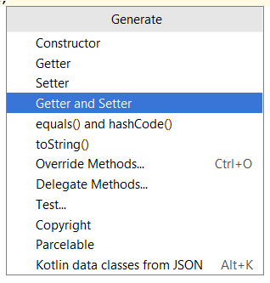
Mapping Data
<resources>
...
<string-array name="movie_name">
<item>Spider-Man: Far from Home</item>
<item>Toy Story 4</item>
<item>Shazam!</item>
<item>Detective Conan: The Fist of Blue Sapphire</item>
<item>Dark Phoenix</item>
</string-array>
<array name="movie_photo">
<item>@drawable/poster_spider_man</item>
<item>@drawable/poster_toy_story</item>
<item>@drawable/poster_shazam</item>
<item>@drawable_poster_detective_conan</item>
<item>@drawable/poster_dark_phoenix</item>
</array>
<string-array name="movie_desc">
<item>Movie Description 1</item>
<item>Movie Description 2</item>
<item>Movie Description 3</item>
<item>Movie Description 4</item>
<item>Movie Description 5</item>
</string-array>
<string-array name="movie_date">
<item>June 28, 2019</item>
<item>June 19, 2019</item>
<item>May 23, 2019</item>
<item>April 12, 2019</item>
<item>June 05, 2019</item>
</string-array>
</resources>
public class Movie {
private int photo;
private String name;
private String date;
private String desc;
public int getPhoto() {
return photo;
}
public void setPhoto(int photo) {
this.photo = photo;
}
public String getName() {
return name;
}
public void setName(String name) {
this.name = name;
}
public String getDate() {
return date;
}
public void setDate(String date) {
this.date = date;
}
public String getDesc() {
return desc;
}
public void setDesc(String desc) {
this.desc = desc;
}
}
public class Movie {
private int photo;
private String name;
private String date;
private String desc;
}
Alt + Insert

Slide 9
Mapping Data
public class MainActivity extends AppCompatActivity {
private String[] movieName;
private String[] movieDate;
private String[] movieDesc;
private TypedArray moviePhoto;
private ArrayList<Movie> movieArrayList;
@Override
protected void onCreate(@Nullable Bundle savedInstanceState) {
super.onCreate(savedInstanceState);
setContentView(R.layout.activity_main);
prepareData();
addItem();
// use data for the ListView here
}
private void prepareData() {
. . . .
}
private void addItem() {
. . . . .
}
}
public class MainActivity extends AppCompatActivity {
. . . . .
private void prepareData() {
movieName = getResources().getStringArray(R.array.movie_name);
movieDate = getResources().getStringArray(R.array.movie_date);
movieDesc = getResources().getStringArray(R.array.movie_desc);
moviePhoto = getResources().obtainTypedArray(R.array.movie_photo);
}
private void addItem() {
movieArrayList = new ArrayList<>();
for (int i = 0; i < movieName.length; i++) {
Movie movie = new Movie();
movie.setName(movieName[i]);
movie.setDate(movieDate[i]);
movie.setDesc(movieDesc[i]);
movie.setPhoto(moviePhoto.getResourceId(i, -1));
movieArrayList.add(movie);
}
}
}

Slide 10
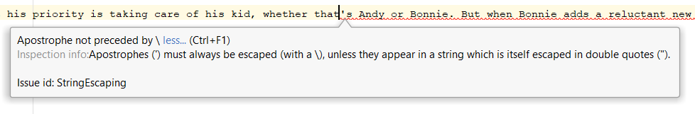
Escaping Data
<resources>
...
<string-array name="movie_desc">
...
<item>...of his kid, whether that's Andy or Bonnie...</item>
...
</string-array>
...
</resources>

Slide 11
Menerapkan Parcelable
listView.setOnItemClickListener(new AdapterView.OnItemClickListener() {
@Override
public void onItemClick(AdapterView<?> parent, View view, int position, long id) {
Intent intent = new Intent(MainActivity.this, DetailMovieActivity.class);
intent.putExtra("name", movieArrayList.get(position).getName());
intent.putExtra("date", movieArrayList.get(position).getDate());
intent.putExtra("desc", movieArrayList.get(position).getDesc());
intent.putExtra("photo", movieArrayList.get(position).getPhoto());
startActivity(intent);
}
});

Slide 12
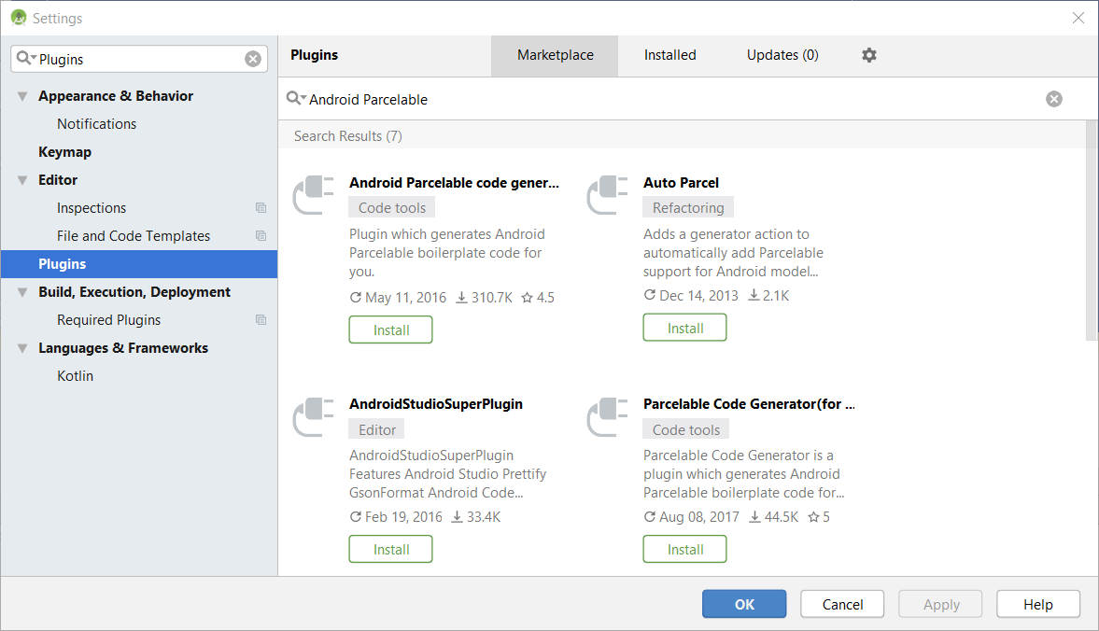
Menerapkan Parcelable

Slide 13
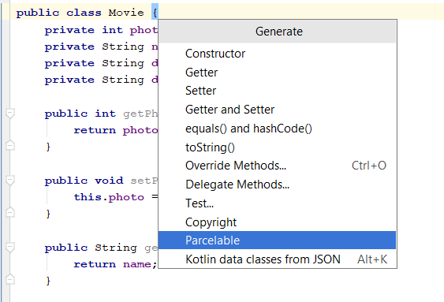
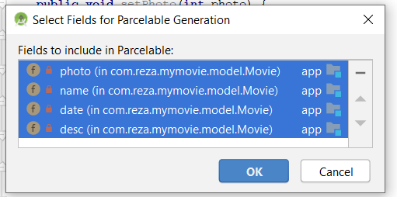
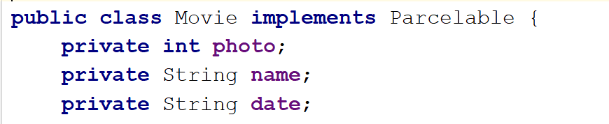
Menerapkan Parcelable

Slide 14
Menerapkan Parcelable
listView.setOnItemClickListener(new AdapterView.OnItemClickListener() {
@Override
public void onItemClick(AdapterView<?> parent, View view, int position, long id) {
Intent intent = new Intent(MainActivity.this, DetailMovieActivity.class);
intent.putExtra("KEY_EXTRA", movieArrayList.get(position));
startActivity(intent);
}
});
Movie movie = getIntent().getParcelableExtra("KEY_EXTRA");

Slide 15
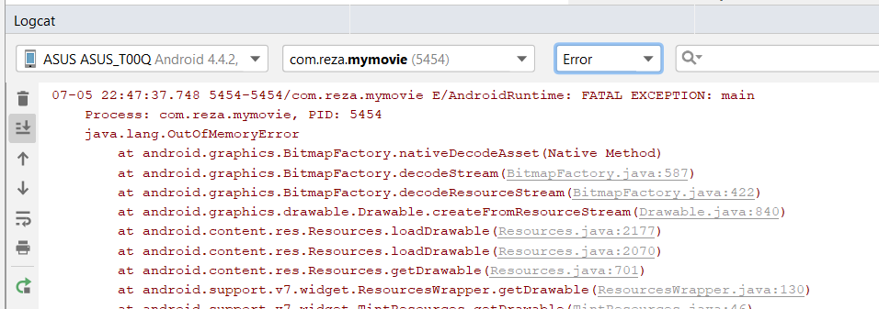
Menampilkan aset gambar pada halaman
imgPhoto.setImageResource(movie.getPhoto());
Disarankan menggunakan library seperti Glide atau Picasso untuk menampilkan gambar.

Slide 16
Menampilkan aset gambar pada halaman
build.gradle (Module: app)
dependencies {
...
implementation 'com.squareup.picasso:picasso:2.71828'
}
Cara menggunakannya
Picasso.get().load(movie.getPhoto()).fit().centerCrop().into(imageView);

Slide 17

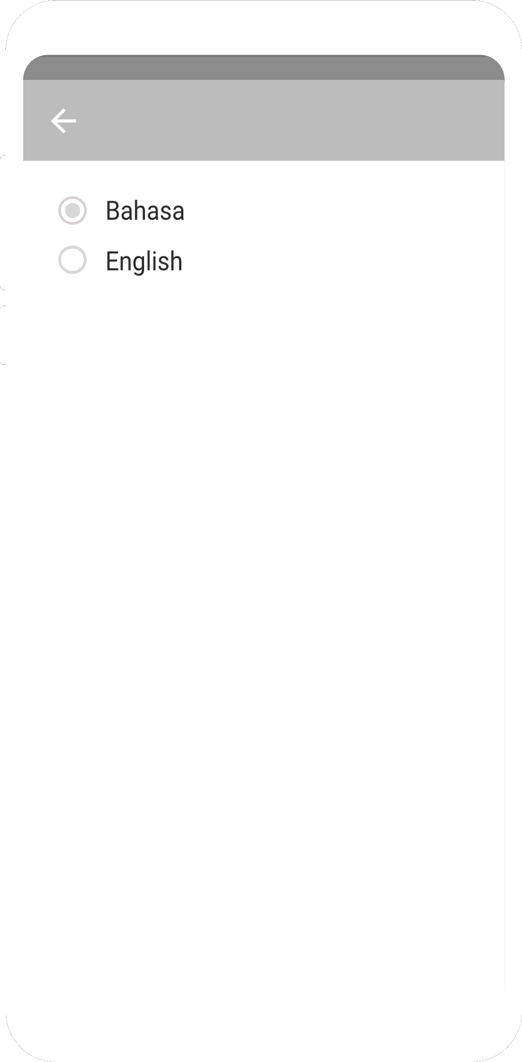
Submission 2
Aplikasi Movie Catalogue (UI/UX)

Slide 18
Kriteria pada Fitur Daftar Film
Terdapat 2 (dua) halaman yang menampilkan daftar film (Movies dan TV Shows)
Menggunakan Fragment untuk menampung halaman Movies dan TV Shows

Slide 19
Kriteria pada Fitur Daftar Film
Menggunakan TabLayout atau BottomNavigationView atau NavigationDrawer, atau yang lainnya sebagai navigasi antar halaman Movies dan TV Shows

Slide 20
Kriteria pada Fitur Daftar Film
Menggunakan RecyclerView untuk menampilkan daftar film dengan jumlah minimal 10 item

Slide 21
Kriteria pada Fitur Detail Film
Menggunakan ConstraintLayout untuk menyusun layoutnya.

Slide 22
Kriteria pada Fitur Localization
Aplikasi harus mendukung bahasa Indonesia dan bahasa Inggris.

Slide 23
Common Problem Submission 2
1
Menampilkan gambar pada halaman
Membuka Detail Activity saat item diklik
Kesalahan penggunaan ConstraintLayout

Slide 24
Menampilkan gambar pada halaman
Picasso.get().load("https://image.tmdb.org/avengers.jpg").into(imageView);
Glide.with(context)
.load("https://image.tmdb.org/avengers.jpg")
.into(holder.imgPhoto);
<uses-permission android:name="android.permission.INTERNET" />

Slide 25
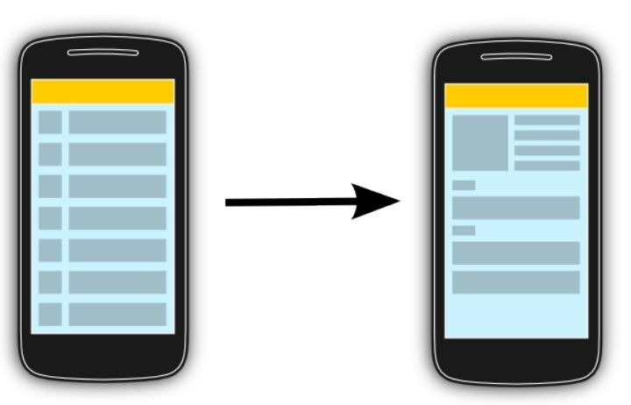
Membuka Detail Activity
Materi: RecyclerView - Latihan : ItemClickSupport pada RecyclerView

Slide 26
Membuka Detail Activity
class ListMovieAdapter extends RecyclerView.Adapter<VH> {
...
OnItemClickListener mOnclickListener;
...
public interface OnItemClickListener {
void onItemClicked(Movie movie);
}
}
holder.itemView.setOnClickListener(new View.OnClickListener() {
@Override
public void onClick(View v) {
Movie movie = getListMovie().get(position);
mOnItemClickListener.onItemClicked(movie);
}
});

Slide 27
Membuka Detail Activity
listMovieAdapter.setOnItemClickListener(new ListMovieAdapter.OnItemClickListener() {
@Override
public void onItemClicked(Movie movie) {
Intent intent = new Intent(MainActivity.this, DetailMovieActivity.class);
intent.putExtra("KEY_EXTRA", movie);
startActivity(intent);
}
});

Slide 28
Penggunaan ConstraintLayout
<ConstraintLayout>
. . .
<ImageView... />
<TextView... />
. . .
<LinearLayout...>
<RelativeLayout>
<LinearLayout>
. . .
. . .
</LinearLayout>
</RelativeLayout>
</LinearLayout>
. . .
</ConstraintLayout>

Slide 29
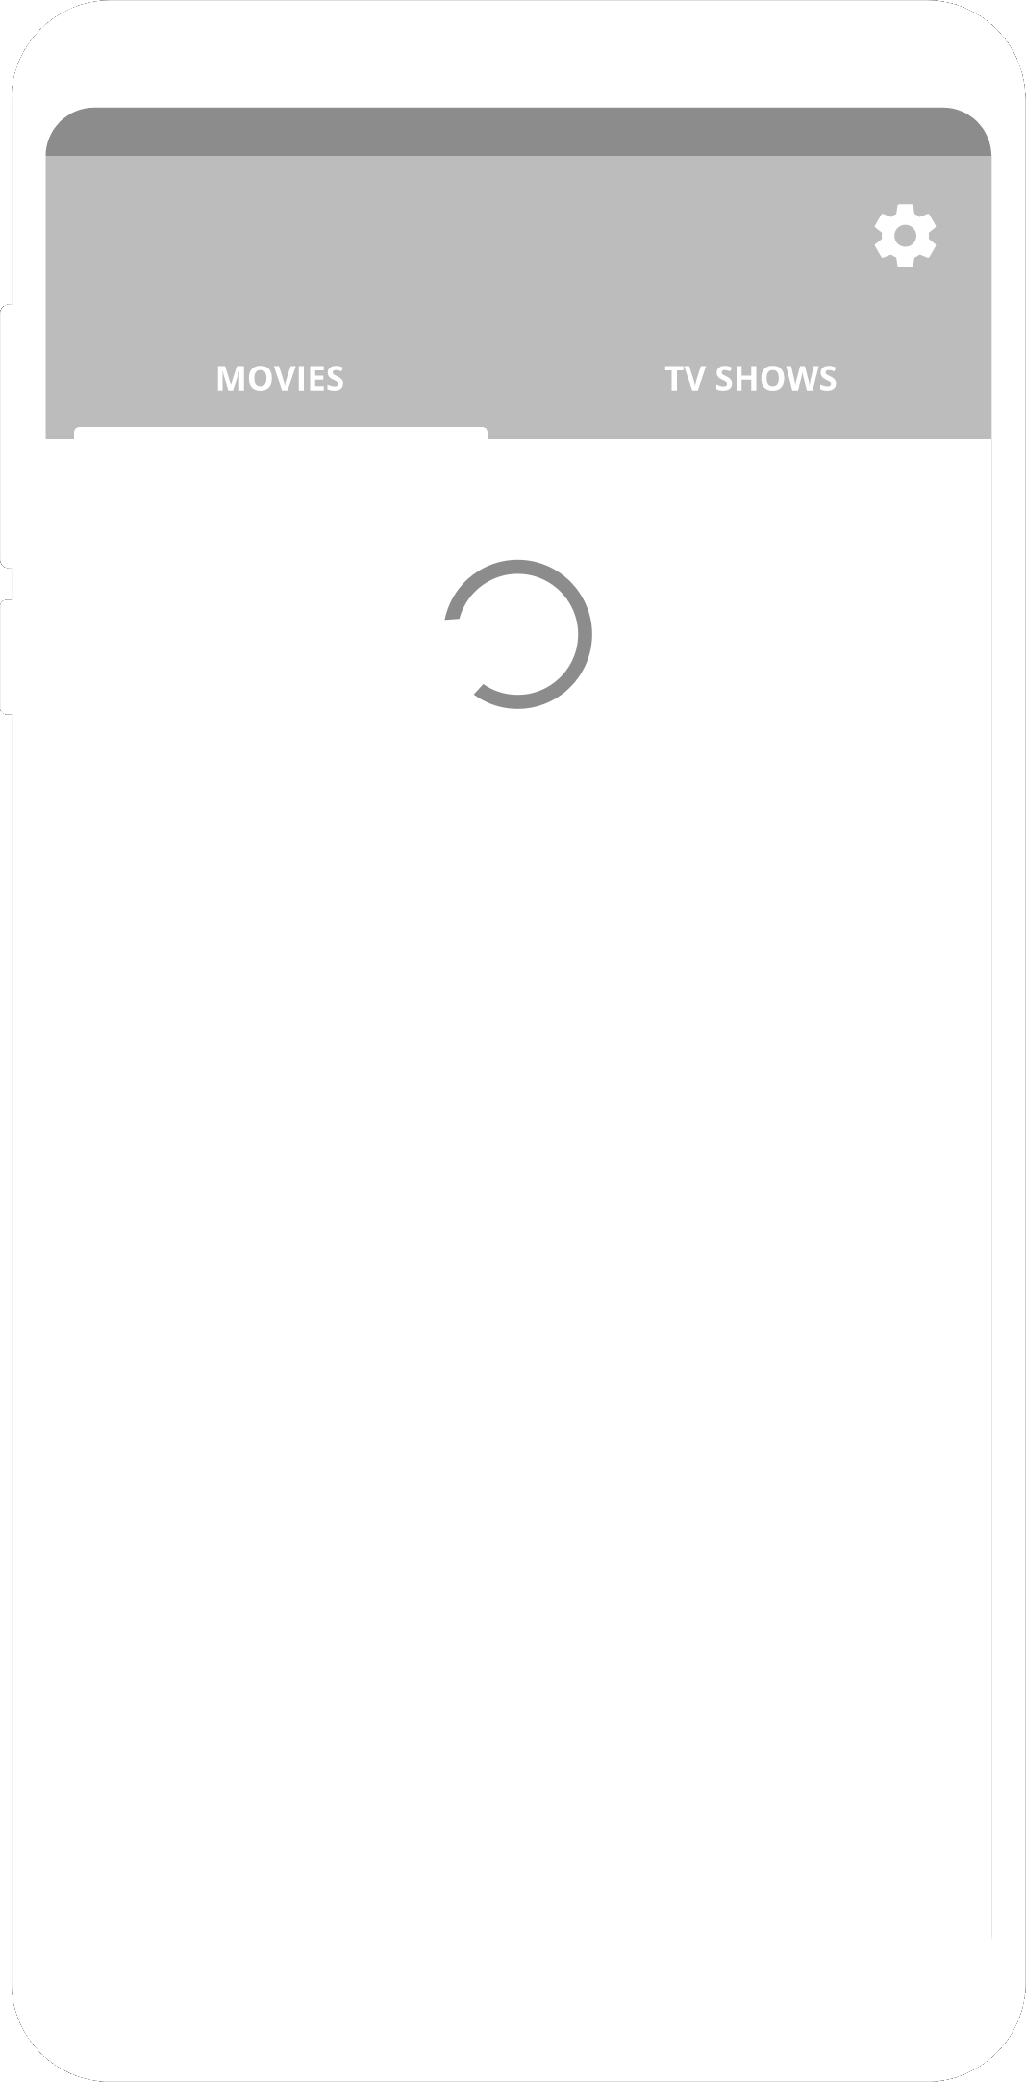
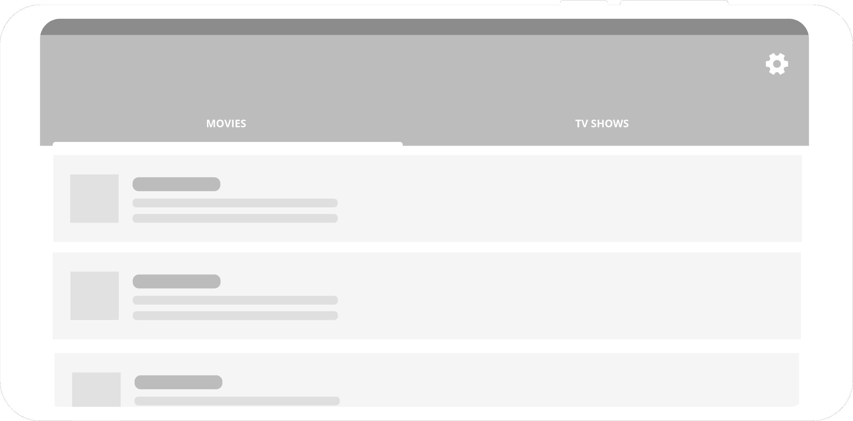
Submission 3
Aplikasi Movie Catalogue (API)

Slide 30
Kriteria pada Fitur Daftar dan Detail Film
Menampilkan indikator loading ketika data sedang dimuat.

Slide 31
Kriteria pada Configuration Changes
Aplikasi harus bisa menjaga data yang sudah dimuat ketika terjadi pergantian orientasi dari potrait ke landscape atau sebaliknya.

Slide 32
Common Problem Submission 3
1
Mengambil data dari web service
Parsing data dari JSON
Menjaga data pada pergantian orientasi dari potrait ke landscape atau sebaliknya.

Slide 33
Mengambil data dari web service
Materi: Job Scheduler - Latihan: Job Scheduler Sederhana
dependencies {
...
implementation 'com.loopj.android:android-async-http:1.4.9'
}
AsyncHttpClient client = new AsyncHttpClient();
String url = "https://api.themoviedb.org/3/discover/movie?api_key=abcdefg&language=en-US";
client.get(url, new AsyncHttpResponseHandler() {
@Override
public void onSuccess(int statusCode, Header[] headers, byte[] responseBody) {
String result = new String(responseBody);
// proses result-nya
}
@Override
public void onFailure(int statusCode, Header[] headers, byte[] responseBody, Throwable error) {
// ...
}
});

Slide 34
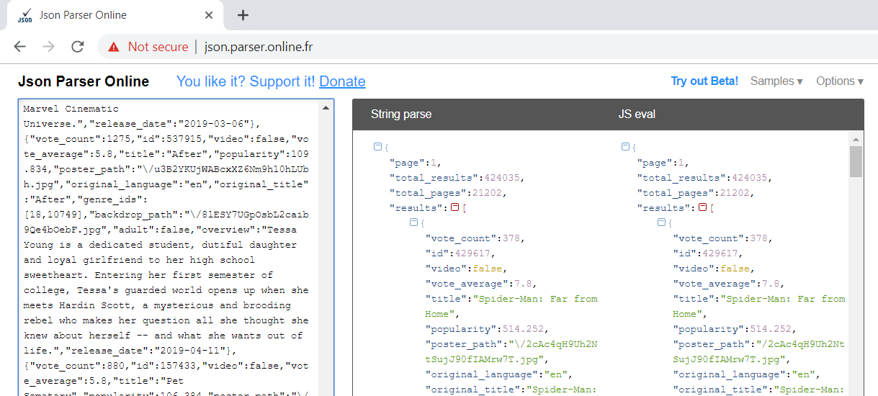
Parsing data dari JSON

Slide 35
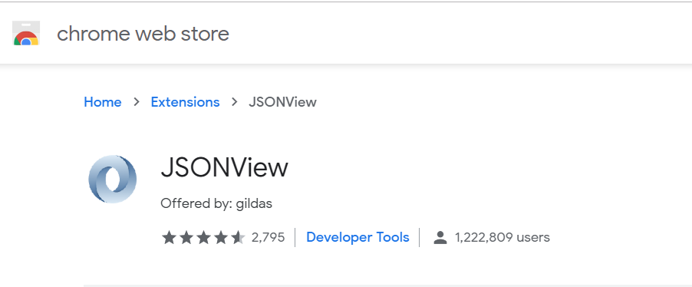
Parsing data dari JSON

Slide 36
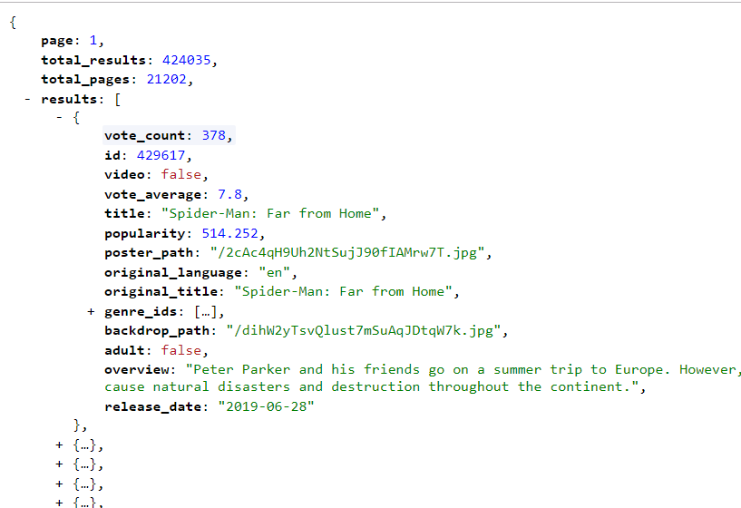
Parsing data dari JSON

Slide 37
Parsing data dari JSON
// proses result-nya
try {
JSONObject responseObject = new JSONObject(result);
JSONArray arrayResult = responseObject.getJSONArray("results");
for (int i = 0; i < arrayResult.length(); i++) {
JSONObject movieObject = arrayResult.getJSONObject(i);
Movie movie = new Movie();
movie.setName(movieObject.getString("title"));
movie.setPoster("https://image.tmdb.org/t/p/w185" + movieObject.getString("poster_path"));
// …
movieArrayList.add(movie);
}
}catch (Exception e){
// handle error parsing
}

Slide 38
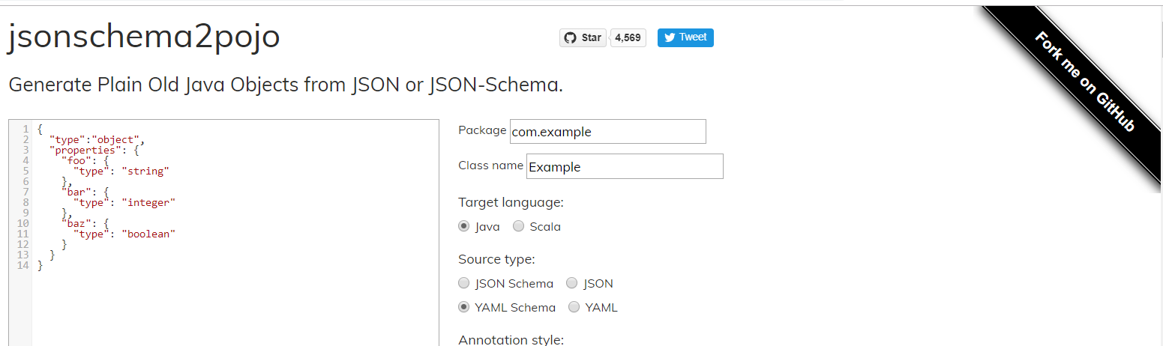
Parsing data dari JSON
Menggunakan library serperti Gson, Jakson, Moshi dll.
dependencies {
. . .
implementation 'com.google.code.gson:gson:2.8.5'
}

Slide 39
Parsing data dari JSON
public class Movie {
@SerializedName("vote_count")
private Integer voteCount;
@SerializedName("id")
private Integer id;
@SerializedName("video")
private Boolean video;
@SerializedName("vote_average")
private Double voteAverage;
@SerializedName("title")
private String title;
@SerializedName("popularity")
private Double popularity;
@SerializedName("poster_path")
private String posterPath;
/...
}
public class MovieResponse {
@SerializedName("page")
private Integer page;
@SerializedName("total_results")
private Integer totalResults;
@SerializedName("total_pages")
private Integer totalPages;
@SerializedName("results")
private List<Movie> results = null;
/...
}
Gson gson = new Gson();
MovieResponse response = gson.fromJson(result, MovieResponse.class);
movieArrayList.addAll(response.getResults());

Slide 40
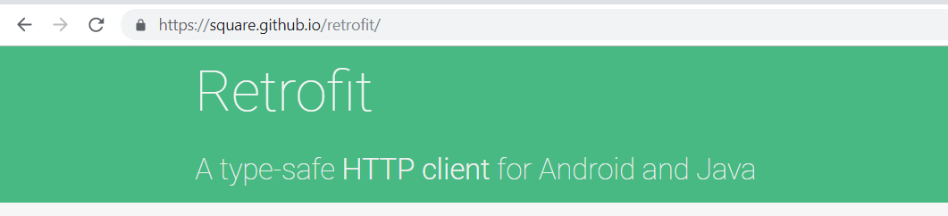
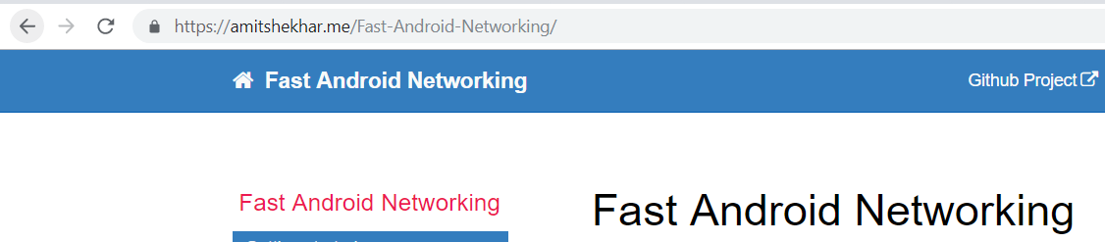

Android Http Library

Slide 41
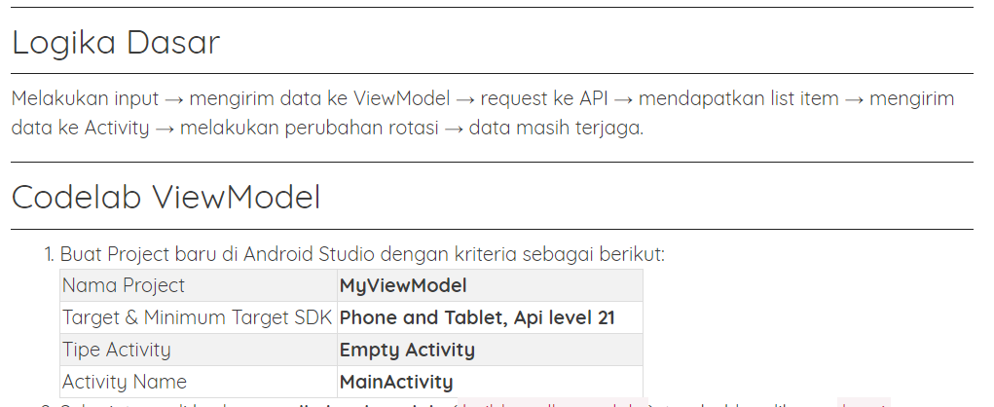
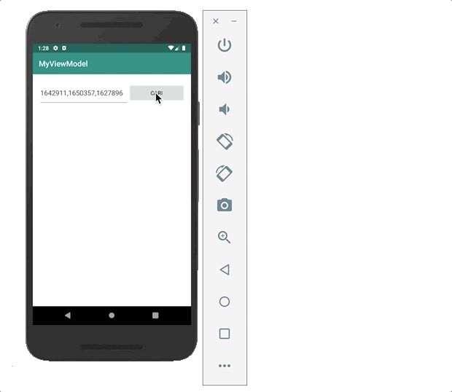
Menjaga data pada pergantian orientasi

Slide 42

Questions?
Let’s meet again on Q.A Session!

Slide 43
References
Tips for Presenting Your Wireframes
3 Steps to Better UI Wireframes
Wireframing for Beginners

Slide 44
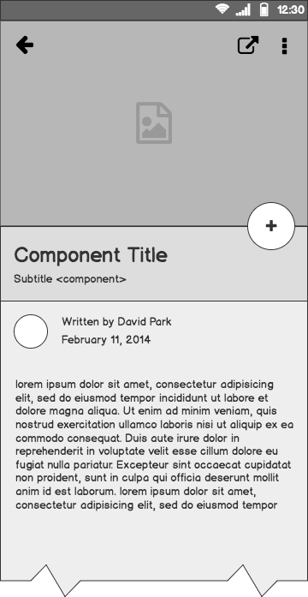
Component Detail (Mobile)
Articulate your design decisions by adding justifications

